Slide 1
Chemical Reactions
Atoms, Molecules, and Energy

Slide 2
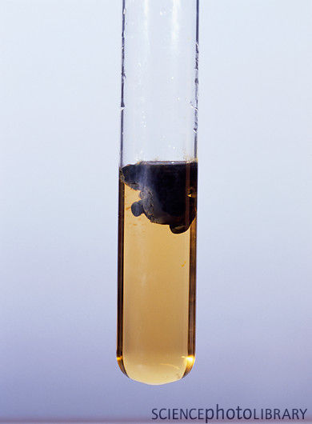
What is a chemical reaction?
One set of substances transforms into another
Often involves energy absorption or release
Common signs of a chemical change
Color change
Precipitate formation: a solid forms in liquid-based reaction
Energy changes (heat, light, etc.)
Odor (new chemicals smell differently)
Gas release

Slide 3
Parts of a chemical reaction
Reactant: a substance that enters into a chemical reaction
Product: a substance formed in a chemical reaction
→ is read “yields”

Slide 4
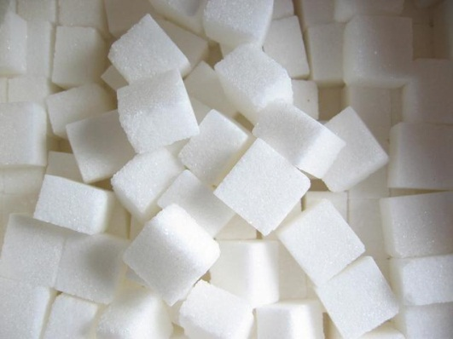
Conservation
Conservation of Matter
Same atoms are present on both sides of the equation
Conservation of Energy
Chemical bonds are like batteries that can store energy
Chemical energy: energy stored in bonds

Slide 5
Energy in Chemical Rxns
Energy is needed to start a chemical rxn
This energy is called activation energy
Forming new bonds can store or release chemical energy
Exothermic: more energy is released than absorbed
Includes rxns that break things down
Ex/ digestion, combustion, cell respiration
Endothermic: more energy is absorbed than released
Includes building rxns
Ex/ DNA synthesis

Slide 6
Balancing Chemical Equations
Because matter must be conserved in chemical equations, we cannot have more reactants or products
Balanced equation: an equation in which the number of each type of atom is equal on each side
Every equation must be balanced
Subscripts cannot be changed – this changes the compound
We use coefficients to balance the equation

Slide 7
Reaction Types
There are various different kinds of chemical reactions
Many of these fall into 5 different types
Classification is based upon how atoms move through the reaction

Slide 8
1. Synthesis:
Two+ substances combine to make a new substance
Element/compound + element/compound → compound
Ex/ 2H₂ + O₂ → 2H₂O

Slide 9
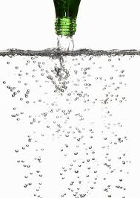
2. Decomposition:
A substance breaks down into simpler substances
compound → two+ elements/compounds
H₂CO₃ → H₂O + CO₂

Slide 10
3. Single Displacement:
One element displaces another in a compound
element + compound → element + compound
Ex/ Cl₂ + 2KBr → 2KCl + Br₂ (Cl displaces Br)

Slide 11
4. Double Displacement:
Positive and negative portions of two compounds are exchanged
compound + compound→compound + compound
Ex/ PbCl₂ + Li₂SO₄ → PbSO₄ + 2LiCl

Slide 12
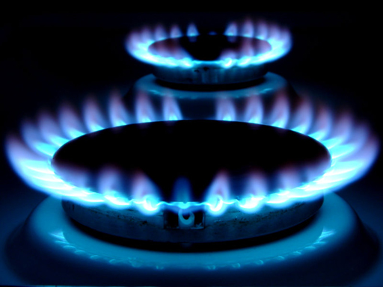
5. Combustion
Oxidation of a fuel
Often involve the burning of a hydrocarbon to produce water and carbon dioxide
Ex/ CH₄ + 2O₂ → CO₂ + 2H₂O
Are exothermic rxns

