Slide 1
Ecosystems of Earth
Terrestrial biomes,
Marine ecosystems,
and Freshwater ecosystems

Slide 2
Biomes:
A regional type of biological community
Locations with the same biome have similar
Climate
Growth patterns
Vegetation
Similar life forms

Slide 3
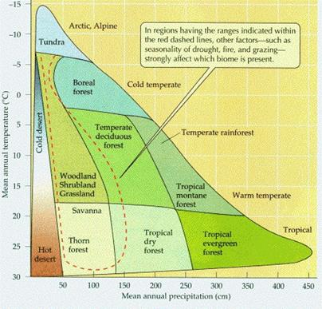
What naturally governs biomes?
1. Temperature
Yearly average and months below freezing are important
Effected by:
Latitude
Bands of similar biomes can be seen around the world
Altitude
Higher places are colder, etc.
Similar climates seen in high mountains world round
2. Precipitation
When does the rain fall?
How much?

Slide 4
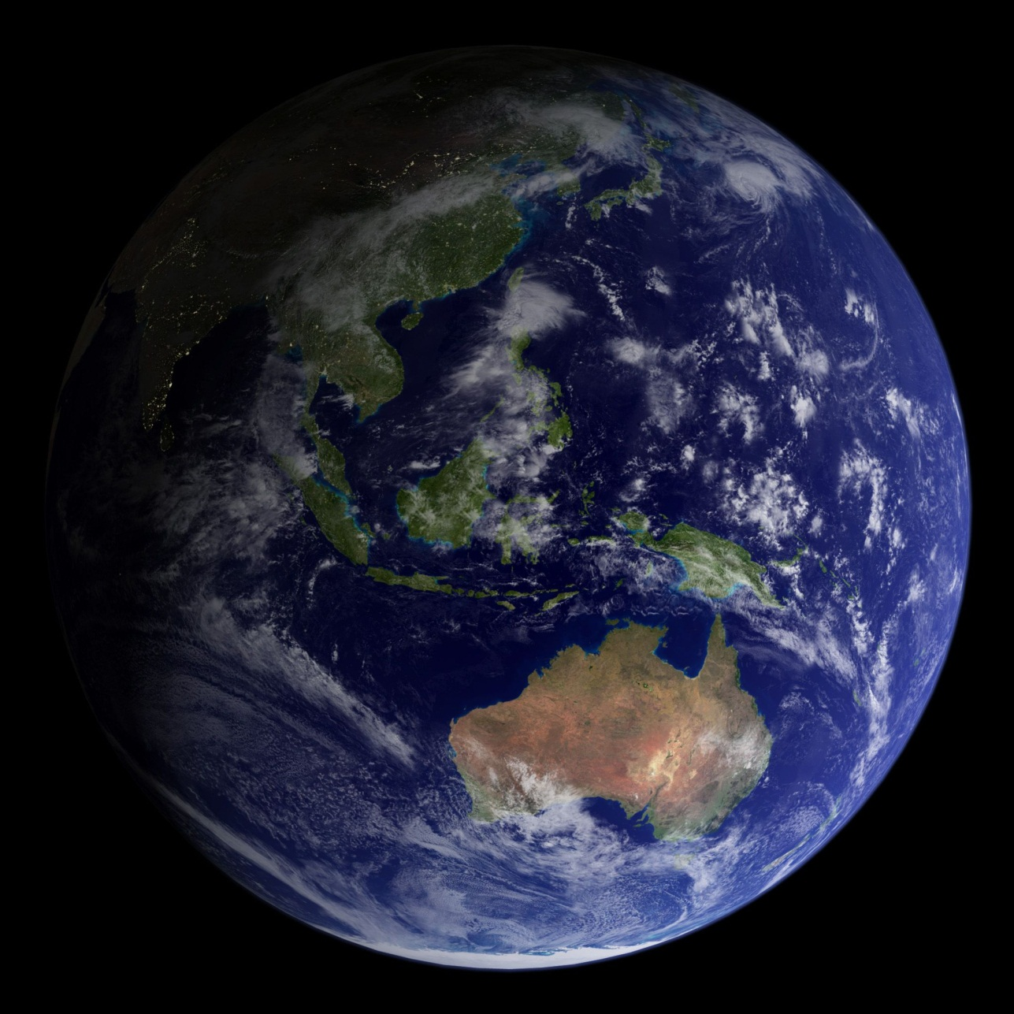
Terrestrial Biomes:

Slide 5
Tropical Moist Forest:
Rainy and warm year-round
Complex biome with many species
Tall trees such as figs reach high above other plants
Different communities exist in the canopy and the ground floor
Nutrients in soil come from rapid decay of dead material
Soil is poor quality
Clear cutting for farming/lumber threatens this ecosystem
Locations: Brazil/Central America, West Africa, South and East Asia, and Oceania

Slide 6
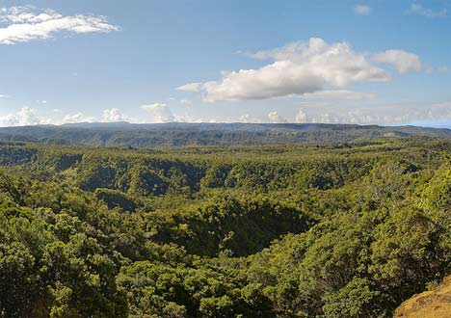
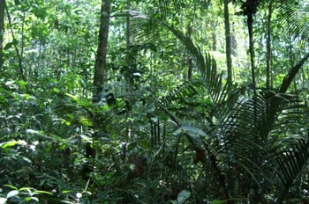
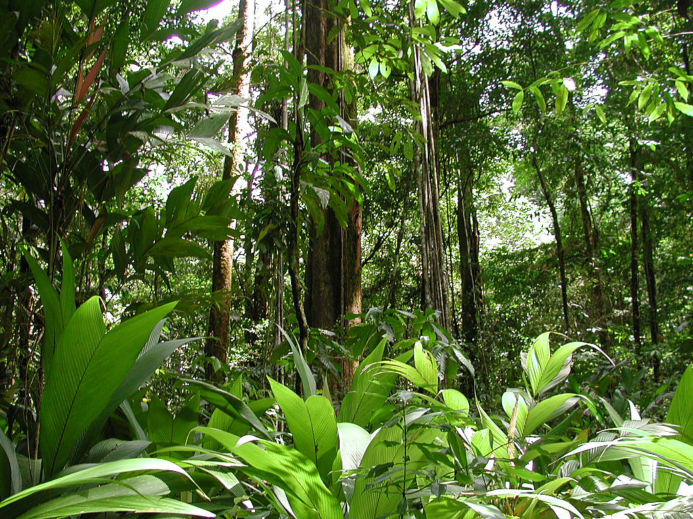

Slide 7
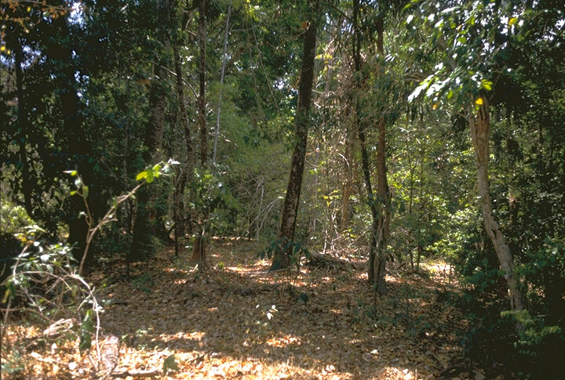
Tropical Seasonal Forest:
Hot year-round but with wet and dry seasons
Often involves monsoons (rain-bearing seasonal winds)
Forests are deciduous in dry seasons
Better for human habitation and farming
Many have been cleared
Locations: Mexico, India, SE Asia

Slide 8
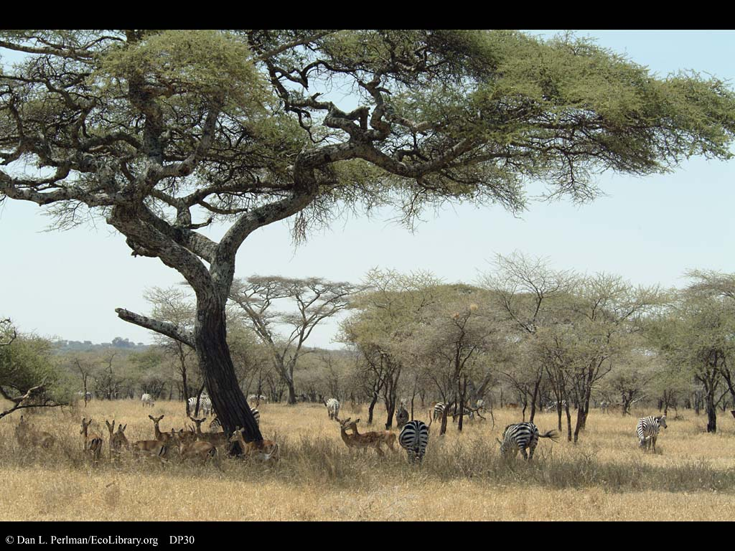
Tropical Dry (Savanna):
Warm year-round with short, unreliable rainy season
Grass is the primary plant
Grazers thrive
Fires renew the ecosystem
Domesticated livestock threaten this ecosystem
Locations: Plains of Africa, N. Australia

Slide 9
Desert:
Temperature can be high or low but rainfall is always low
Less than 30cm/year
Vegetation is sparse
Takes advantage of even small rains
Often occur on one side of mountains or far inland away from oceans
Rain shadow:
Vulnerable to human and livestock intrusion
Locations: Sahara, Gobi, Atacama, SW US

Slide 10
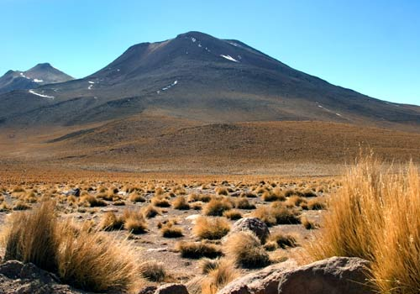
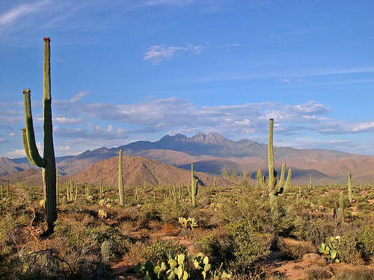
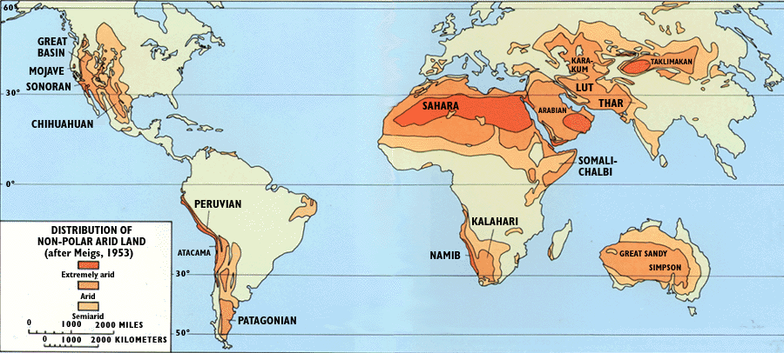

Slide 11
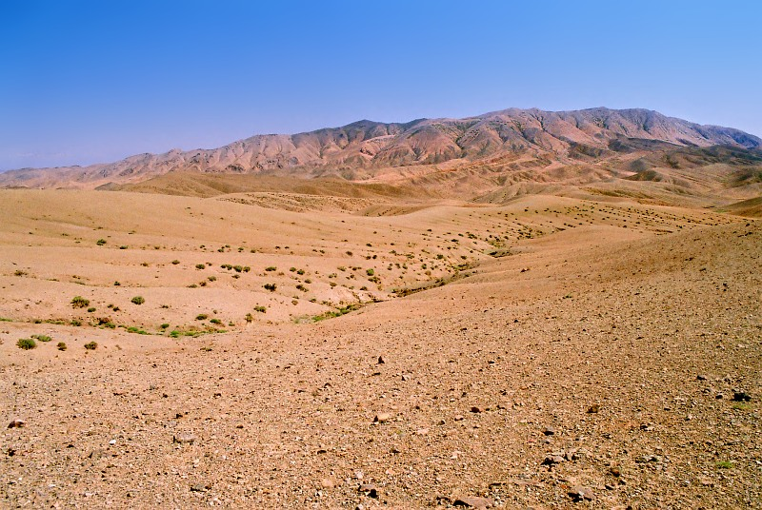
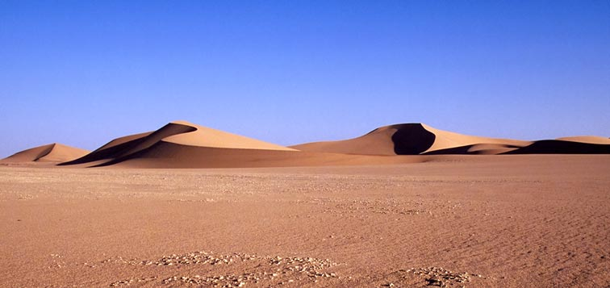

Slide 12
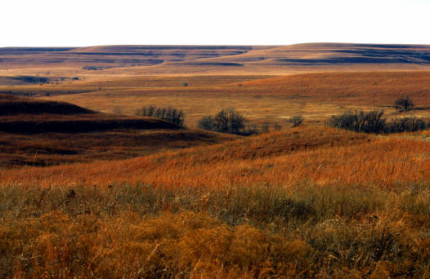
Temperate Grassland:
Occur in areas with warm and cold seasons
Good amount of rain but not enough to support forests
Covered mainly in perennial grasses, shrubs, and forbs
Create fertile soil
Often cleared for cropland or overgrazed
Locations: Central N. America, Central Asia

Slide 13
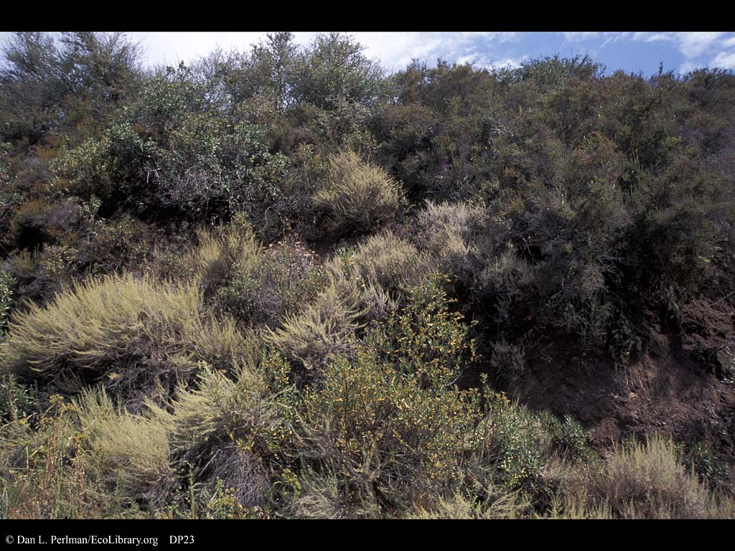
Mediterranean/Chaparral:
Hot, dry summers and cool, moist winters
Drought-tolerant trees and shrubs mix with grasses
Contains unique species
Locations: N. Mediterranean Sea coast, portions of California

Slide 14
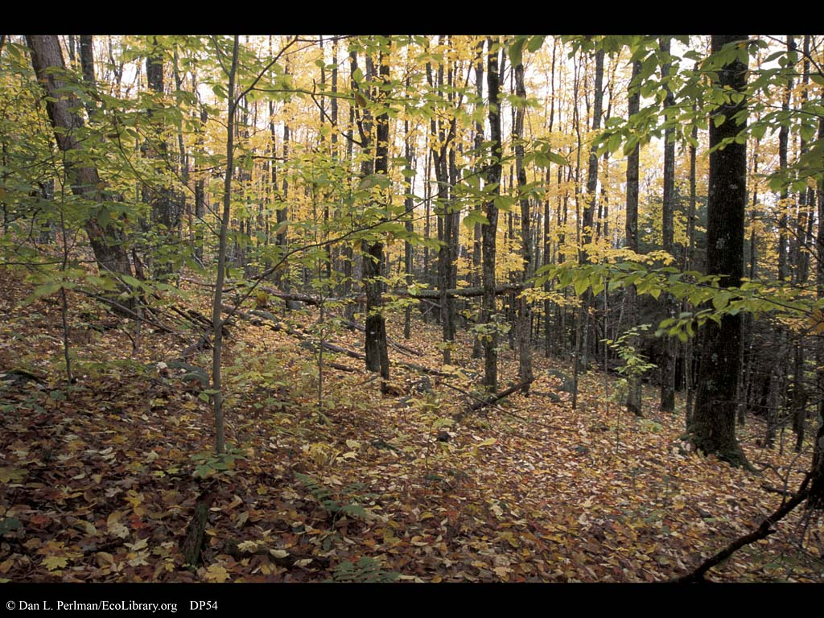
Temperate Deciduous Forest:
Plentiful rainfall year round, with warm and cold seasons
Large broadleaf trees dominate
Deciduous: drop leaves seasonally (in winter here)
Lower, short lived plants arise before the canopy opens in spring
At risk from settlers, loggers
Locations: Eastern N. America, Europe (historically), East China, Korea, and Siberia

Slide 15
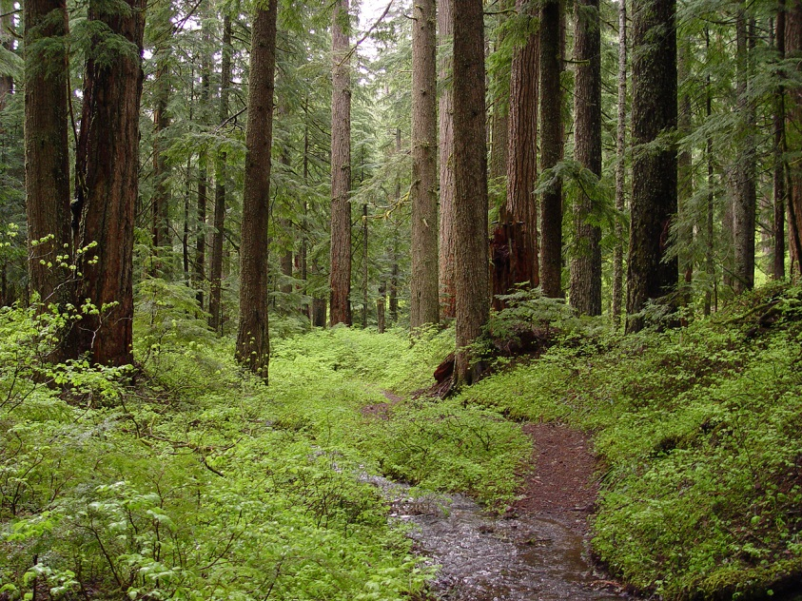
Temperate Coniferous Forest:
Often occur where moisture is limited (sandy soils, colder climates)
Contain evergreen coniferous trees: cone-bearers
Thin waxy leaves reduce moisture loss
Valuable source of timber (fast growing trees)
Locations: Southern Atlantic & Gulf Coast states, mountains
Also includes temperate rainforest of the NW states
Largest tree species found here (red woods & sequoias)

Slide 16
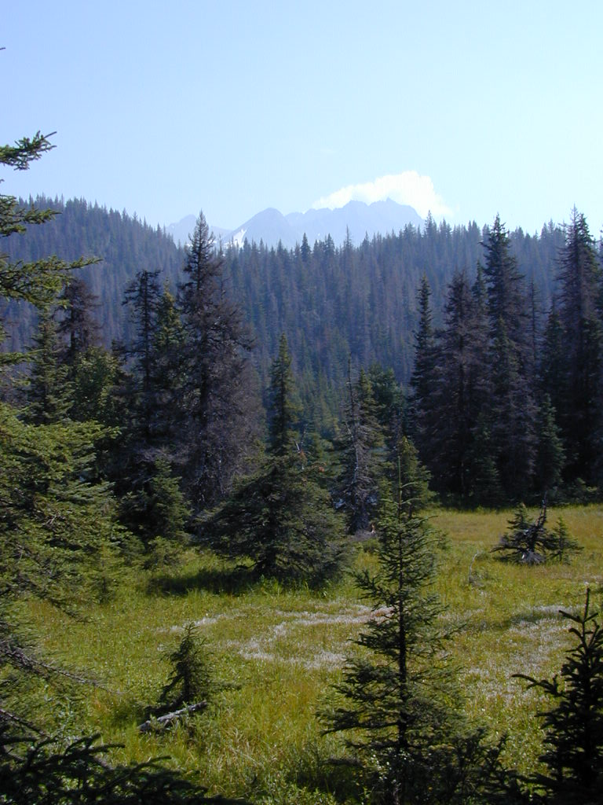
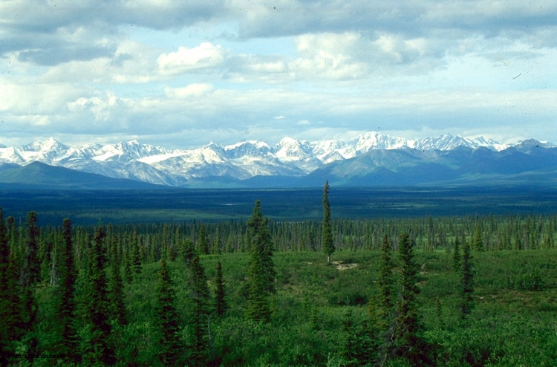
Boreal Forest/Taiga:
Northern forests with ample rain and cool temperatures year round
Supports less animal life due to cold conditions and lack of nutrients
Edge of this forest is known as the taiga, a Russian name
Locations: primarily Alaska, Canada, and Siberia

Slide 17
Tundra:
Temperatures stay below freezing most of the year
Only small, hardy vegetation survives (mosses, lichens, etc.)
Soil remains frozen as permafrost
2 Kinds
Artic: cold due to high latitudes
Serves as nesting site for waterfowl
Alpine: cold due to high elevation
Same vegetation w/ adaptations for height
Somewhat less threatened
Location: primarily Alaska, Canada, and N. Russia

Slide 18
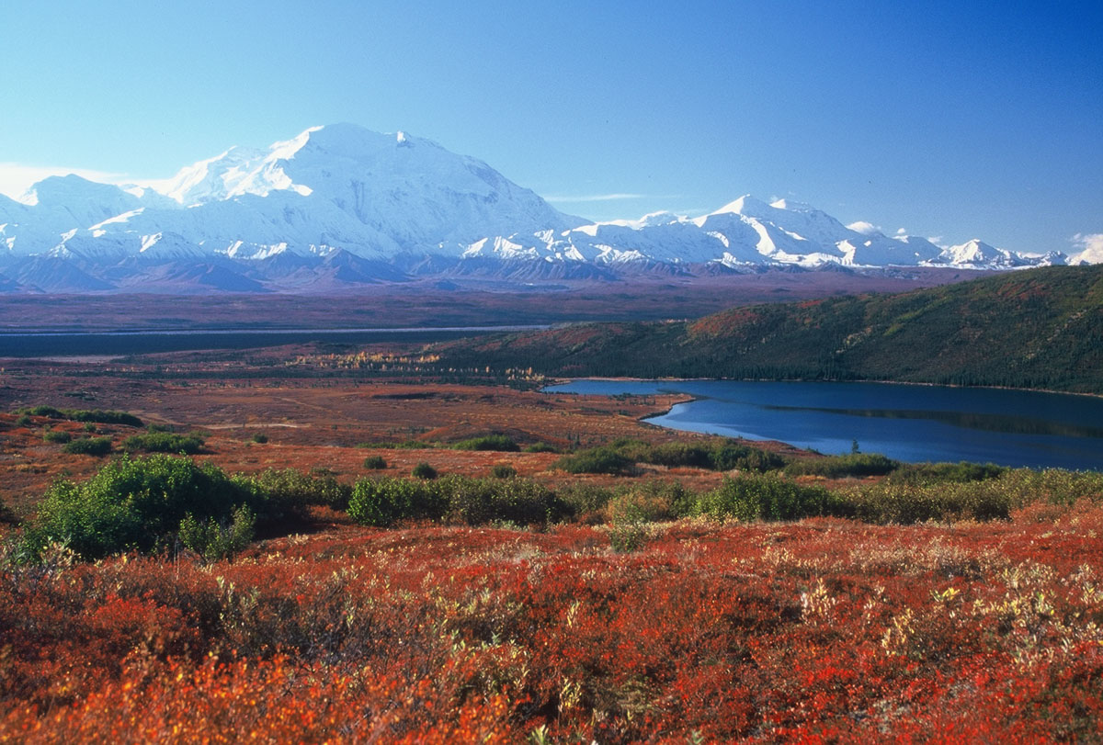

Slide 19
Marine Ecosystems:

Slide 20
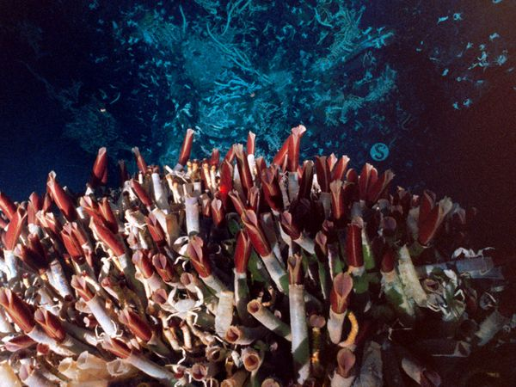
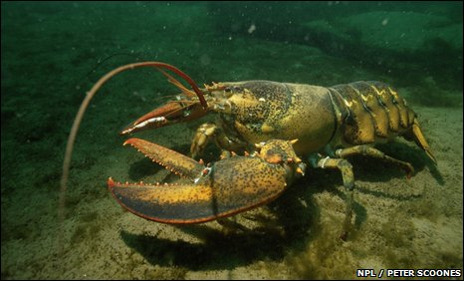
Benthic Ecosystems:
Home on the ocean floor
High O₂ but low nutrients in the cold water (no sunlight)
No plants
Organisms mainly feed on marine snow: dead organic matter falling through the water column
Some others get nutrition from heat released from underwater volcanic eruptions
Animals are bottom feeders: crustaceans, soles, tube worms, etc.
Less threatened and less known to humans

Slide 21
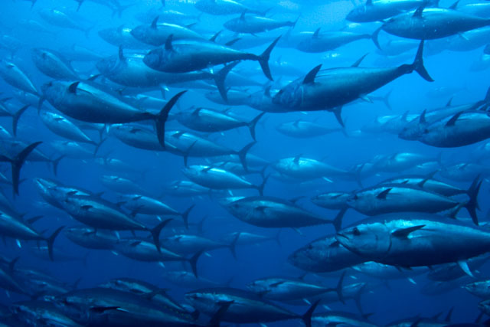
Pelagic Ecosystems
Different zones associated with different depths in the water column
From surface down: Epipelagic, Mesopelagic, Bathypelagic, Abyssopelagic, Hadal
Different organisms inhabit each zone
Plankton, jellyfish, other fish mainly near surface
Squid, jellyfish, larger fish sometimes move up and down deeper depending on time of day

Slide 22
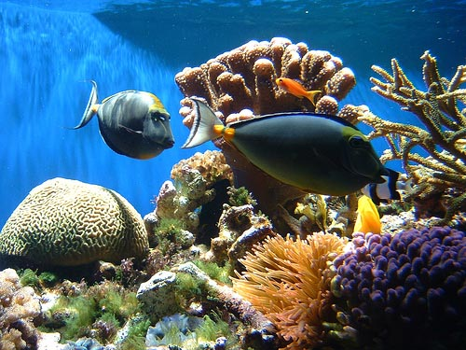
Coral Reefs:
Colonies of small organisms called coral polyps
When polyps die, their skeletons calcify, forming a base for new polyps to grow on
Have a symbiotic relationship with algae for food
Only form in clear water near the surface
Have extraordinary diversity of life
Large numbers of fish species only inhabit reefs
Are incredibly vulnerable
Can be damaged by reckless fishing, changes in temp., invasive fish, and disease, coral bleaching
Ex/ Caribbean, Oceania

Slide 23
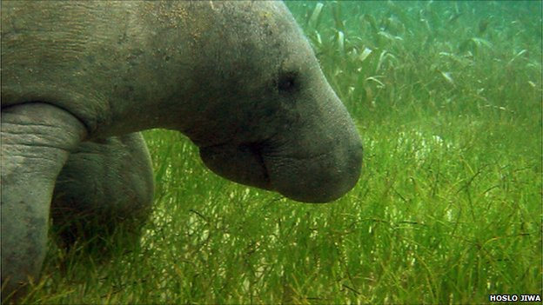
Sea Grass Beds:
Also called eel grass
Found in shallow warm water
Support rich communities
Ex/ Florida: supports manatees

Slide 24
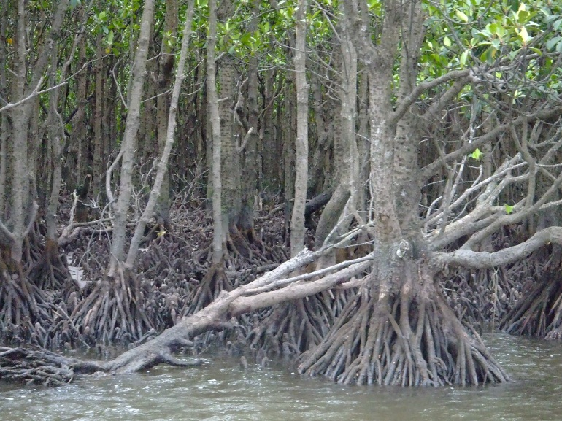
Mangroves
Salt-tolerant trees that grow in large stands along warm, calm coastal waters
Ecologically important
Provide a home for many organisms
Prevent erosion of coasts
Blunt force of tsunami and hurricanes
Threatened by humans
Cut for timber and to make room for aquaculture

Slide 25
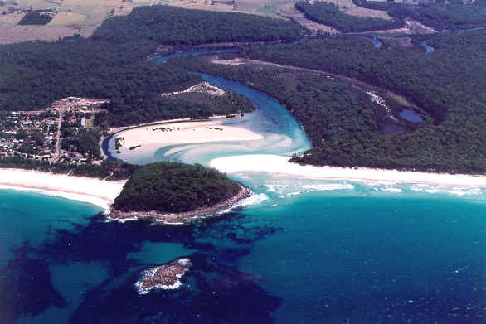
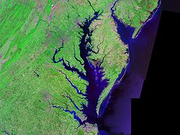
Estuaries/Salt Marshes
Estuary: a bay at the mouth of a river where fresh and salt water mix
Salt marshes: shallow seaside wetlands that often flood with salt water
Both serve as a spawning ground for fish, jellyfish and crustaceans
Formerly were productive fishing grounds
Now many are overwhelmed with pollution

Slide 26
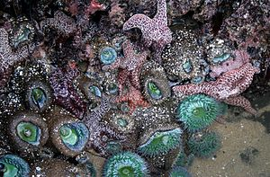
Tide Pools:
Shallow depressions in a rocky coastline that collect water at high tide and hold it at low tide
Contain interesting communities of organisms found few other places
Includes echinoderms, anemones, crustaceans, and mollusks, among others

Slide 27
Freshwater Ecosystems:

Slide 28
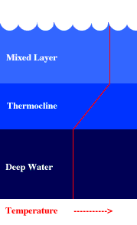
Limnic (Lake) Ecosystems
Differences between lakes depend mainly on nutrients and depth
Deep lakes have little mixing of water from top to bottom
Cold water stays at bottom with warmer sun-heated water near the surface
Thermocline: the boundary between hot and cold
Surface communities include algae and protists, insects and larva, fish and animals
Easily contaminated by runoff, sewage, and wastes

Slide 29
Wetlands
Shallow ecosystems with surface saturated and partly submerged
Get special protection from EPA, others
Crucial for wildlife, especially waterfowl
Retains storm water and filters out contaminants
Many have been drained for land use
Different types described based upon vegetation
Swamps: forested wetlands (trees)
Marshes: no trees; grasses and sedges
Bogs: water saturated ground composed of decayed organic material called peat
Fens: similar to bogs, but fed by groundwater

Slide 30
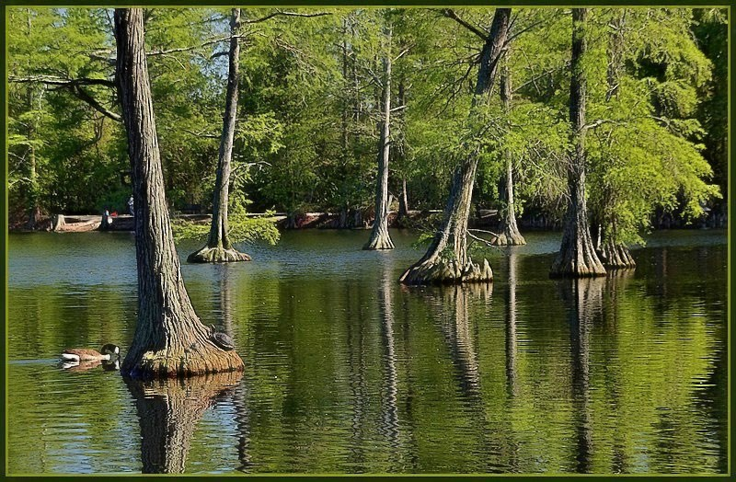
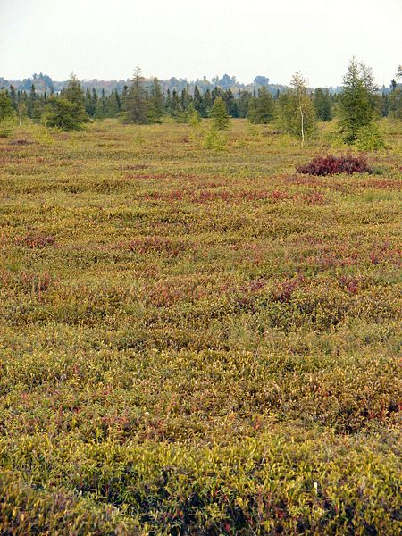
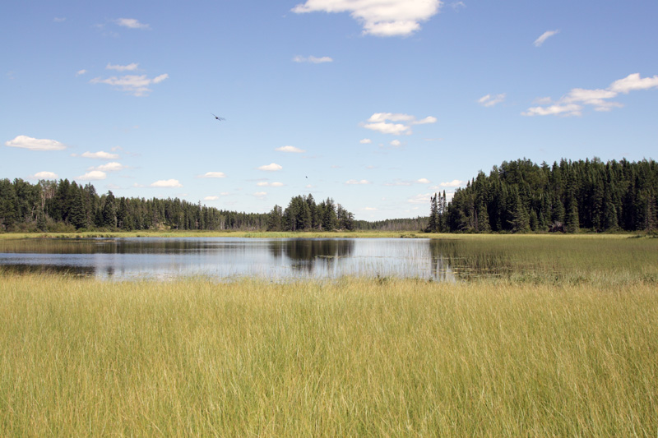

Slide 31
Streams and Rivers
Difference between rivers and streams is not distinct (rivers are bigger)
Parts
Headwaters (Source): beginning of a river (highest point)
Mouth: end of a river where it enters a larger body of water
Bed: bottom surface
Banks: edges
Conditions based upon nutrient availability
Water is well supplied with O₂ due to mixing from current
Materials constantly move downstream
Downstream waters are murkier and river is shallower and slower moving
All connected rivers and streams form a system
Called a watershed: all land drained by a system of rivers and streams

